Slide 1
Welcome to nasa tops Training in Artificial Intelligence and Machine Learning for Space Biological Sciences Using NASA Cloud-Based Data

Slide 2
Introduction to google colab

Slide 3
What is google colab?
Free cloud-based platform for coding and running software programs
Collaborative environment where users can work together (like Google Docs)
Accessible through a web browser
No software installation necessary
Many popular Python libraries are pre-installed
In this course, we will use Google Colab notebooks to run code for data access, data analysis, data visualization, and machine learning model training and evaluation.

Slide 4
Google colab uses the notebook format
Notebook – interactive document combining code, text, and visualizations
Notebooks consist of multiple cells
Code cells – write and execute code. Identified by “In [ ]:” prompt
Text cells – plain text or formatting options such as headings, bullet points, images
Cell output is available as soon as the cell is done running
Notebooks are self-contained and sharable
Enables documentation and reproducibility

Slide 5
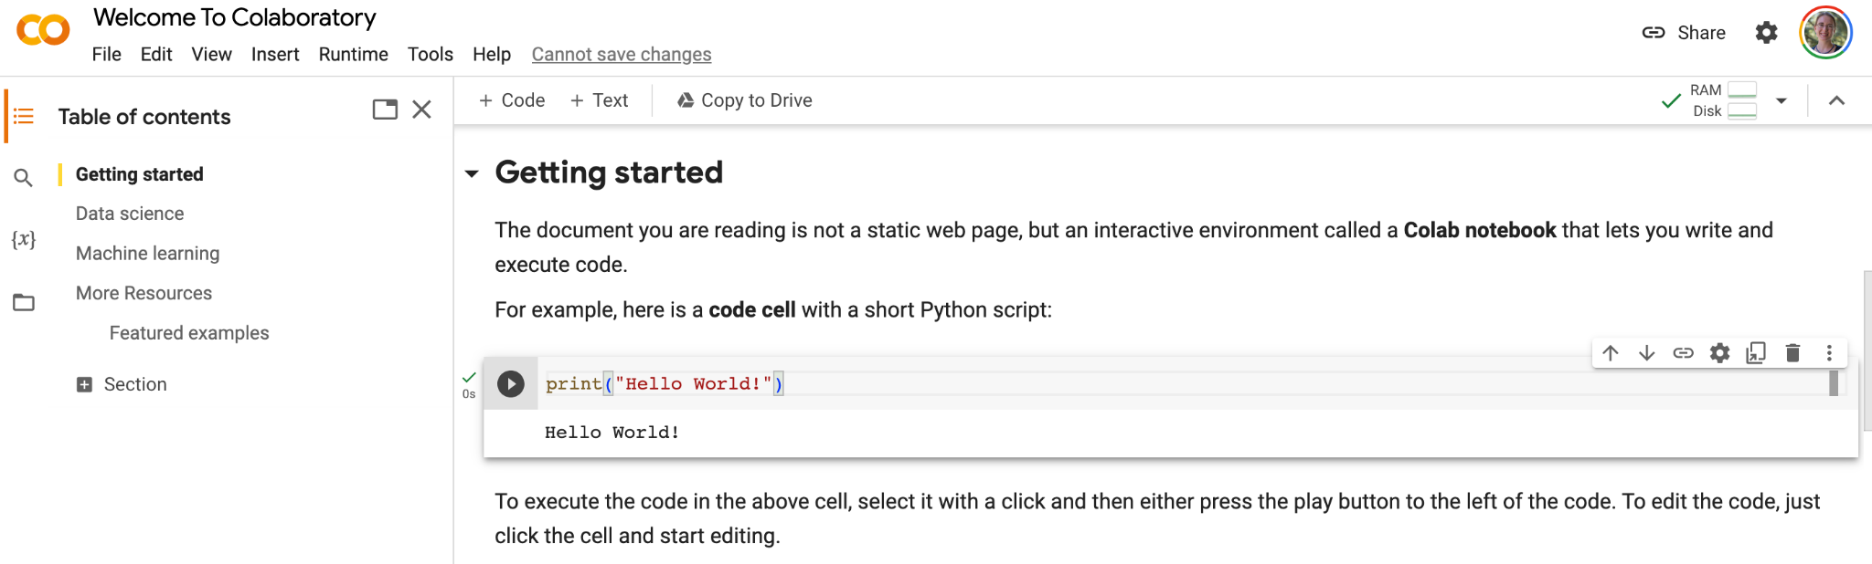
Colab notebook example

Slide 6
Colab notebook example
Text cell

Slide 7
Colab notebook example
Code cell

Slide 8
Colab notebook example
Create new code cell

Slide 9
Colab notebook example
Create new text cell

Slide 10

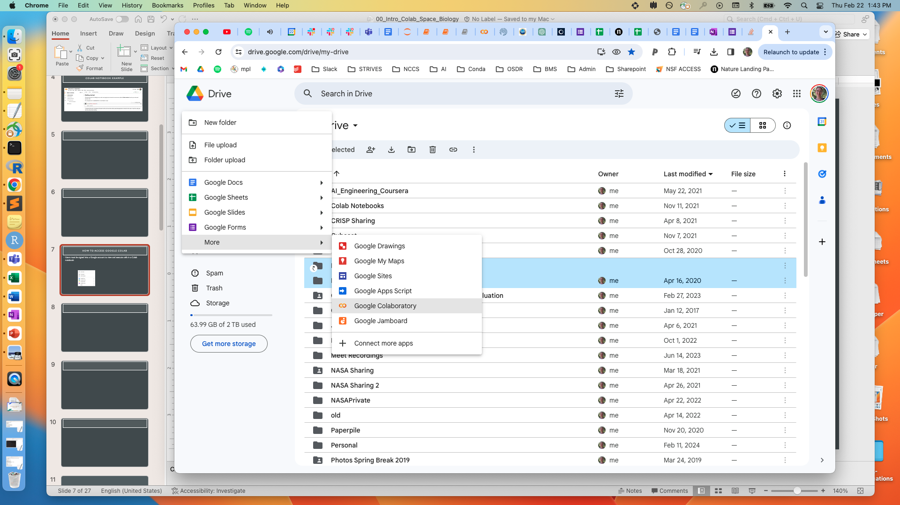

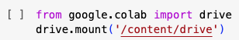
How to access google colab
Users must be signed into a Google account to view and execute cells in a Colab notebook
If you do not have a Google account, visit myaccount.google.com to create an account to continue with this course
New Colab notebooks can be created through Google Drive
Users can find their notebooks in Google Drive under the Colab Notebooks folder
In order to access files stored in Google Drive in a Colab notebook, we will run the following code cell to mount Google Drive
Creating a new Colab notebook

Slide 11
Introduction to space biology

Slide 12
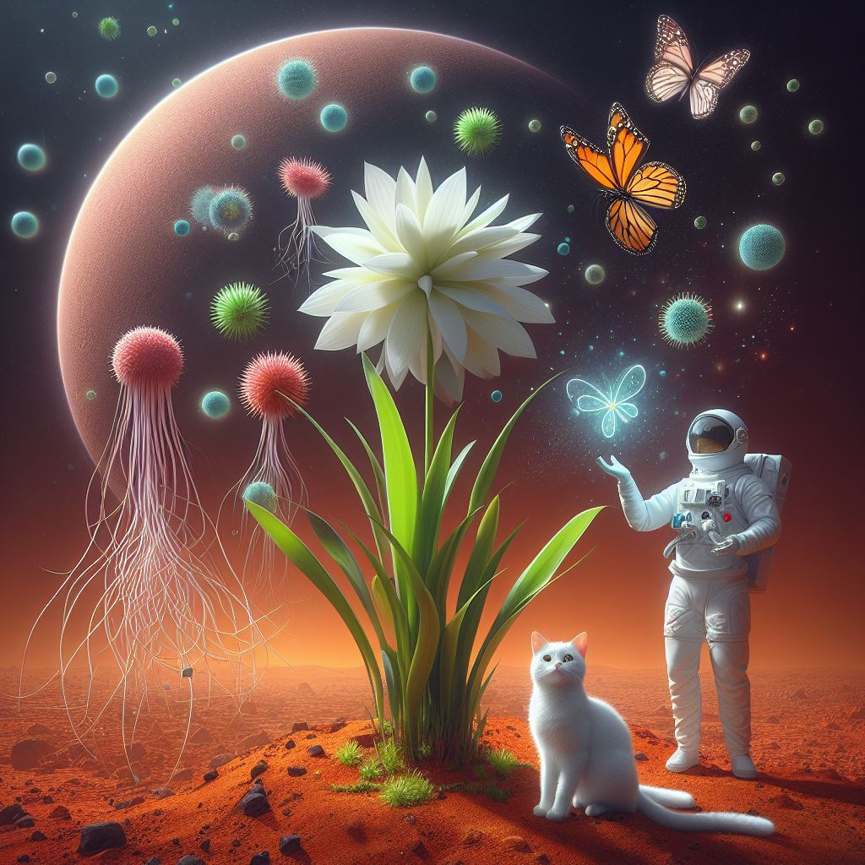
What is space biology?
The study of how living organisms respond to the hazards of spaceflight
Hazards of Spaceflight:
Radiation
Altered gravity
Hostile and closed environments
Distance from Earth
Confinement

Slide 13
Potential health consequences of space travel
Radiation
Cancer
Oxidative stress
Vision changes
Bone loss
Altered gravity
Muscle atrophy
Oxidative stress
Vision changes
Bone loss
Cardiovascular and immune effects, hypercapnia
Hostile and closed environments
Infections
Nutrition and mood
Sleep disruption
Stress
Distance from Earth
Limited health care support and resources
Confinement
Lowered fitness
Nutrition and mood
Sleep disruption
Afshinnekoo et al., Cell 2020

Slide 14
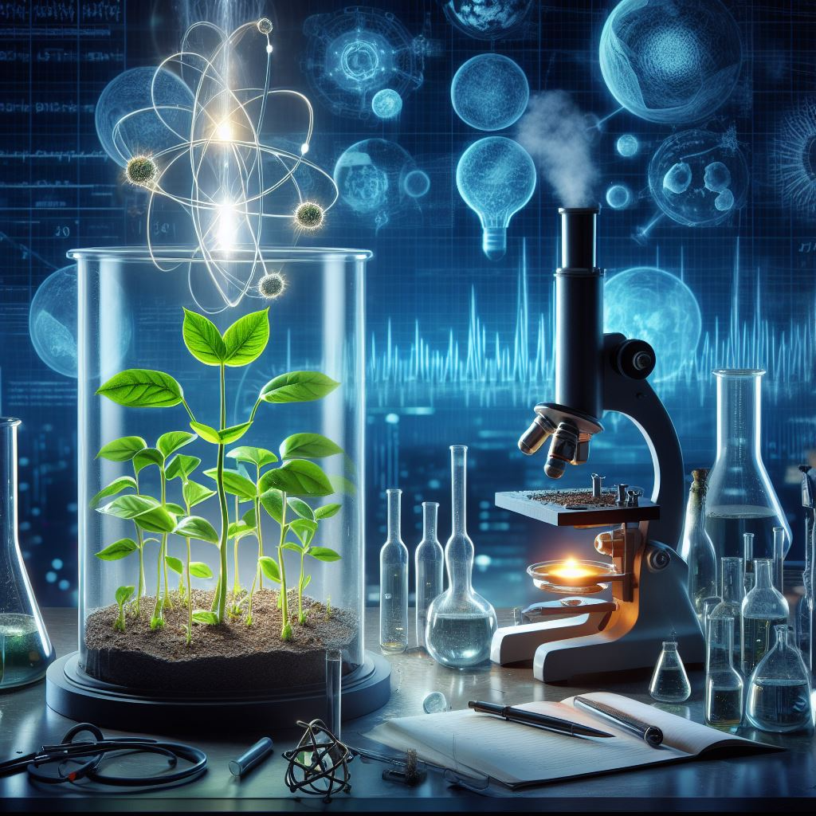
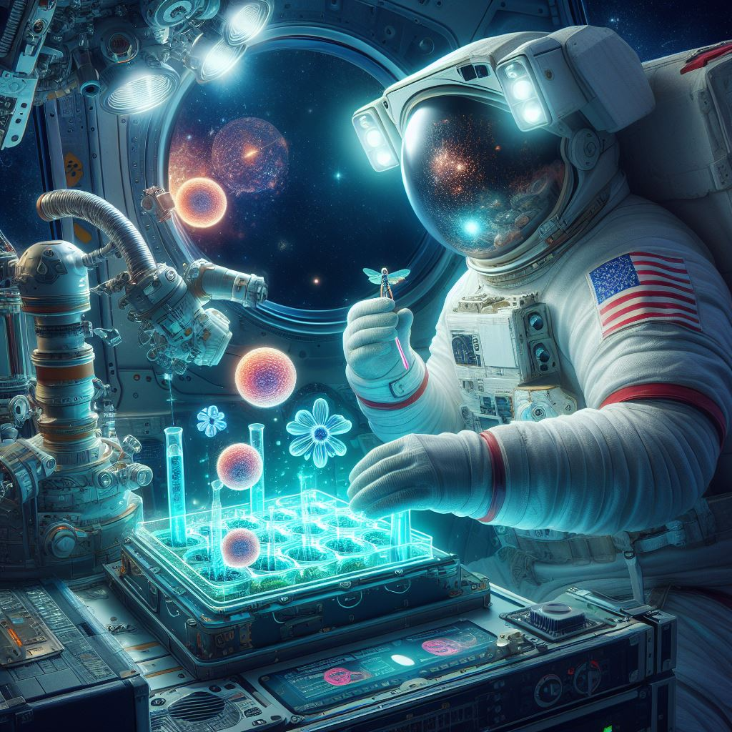
Space biology research methods
Ground-Based Studies: Simulate space conditions on Earth to investigate biological responses.
Centrifuges – mimic effects of microgravity
Particle accelerators and radiation sources – radiation exposure
Neutral buoyancy facilities – simulate weightlessness
Spaceflight Experiments: Conduct research aboard spacecraft, space stations, high-altitude balloons, or suborbital flights.
Model Organisms such as rodents, fruit flies, worms, fish, and plants are used

Slide 15
History of space biology research
1960s
Early Studies on the Effects of Microgravity
1970s-80s
Exploration of Cellular and Physiological Changes in Microgravity
1990s-Present
Advancements in Molecular Biology, Genomics, and Biotechnology
Subsequent life sciences experiments on crewed space capsules (Mercury, Vostok)
First animal in space: Laika the dog, Sputnik 2, 1967
Effects of microgravity on basic biological processes: growth, development, reproduction, orientation in space
Space shuttle missions provided larger experimentation platforms
Cellular biology, neurophysiology, muscle atrophy, bone density loss, and immune system function in microgravity conditions
Cellular and molecular studies, physiological animal studies
International space stations: Mir & International Space Station (ISS)
Wide variety of space biology experiments and advanced technologies
Studying the effects of combined microgravity and radiation
Potential applications of biotechnology in space (3D bioprinting, tissue engineering)

Slide 16










space biology is international
NASA (United States):
Studies space biology including bone density, muscle strength, immune function, and plant growth aboard the ISS (NASA Biological and Physical Sciences Division).
ESA (Europe):
Explores microgravity effects on biology, including human health, plant growth, and gene expression on the ISS (ESA Biolab Facility).
Roscosmos (Russia):
Investigates space's effects on cosmonauts' health, including bone density, muscle mass, and immune function on the Mir space station and the ISS.
CNSA (China):
Studies space biology including bone metabolism, muscle physiology, immune responses, and plant biology on the Tiangong space station and Shenzhou spacecraft.
JAXA (Japan):
Explores microgravity effects including human health, cellular biology, and plant growth on the ISS.
CSA (Canada):
Investigates bone health, muscle function, and immune responses in space on the ISS.
UK Space Agency:
Studies space's impact including human health, genetics, and plant biology on the ISS.
ASI (Italy):
Researches space's effects on the ISS including human physiology, plant growth, and gene expression.
DLR (Germany):
Explores microgravity effects on the ISS including human health, cellular biology, and plant growth.
CNES (France):
Investigates space's impact including human health, genetics, and plant biology on the ISS.

Slide 17










space biology is international
SSAU (Ukraine):
Researches space's effects including human physiology and plant biology on the ISS.
ROKA (South Korea):
Explores microgravity effects including human health, cellular biology, and plant growth on the ISS.
ISRO (India):
Researches space's impact including human physiology, plant biology, and astrobiology through satellite experiments and international collaborations.
UAESA (United Arab Emirates):
Studies space's impact on human health, genetics, and plant biology.
SUPARCO (Pakistan):
Investigates space's effects on human physiology and astrobiology on board satellites.
CONAE (Argentina):
Explores microgravity effects on human health and genetics on board satellites.
AEB (Brazil):
Studies space's impact on human health, genetics, and plant biology.
SANSA (South Africa):
Researches space's effects on human physiology and astrobiology on board satellites.
NSPO (Taiwan):
Investigates space's impact on human health, genetics, and plant biology.
LAPAN (Indonesia):
Studies space's effects on human physiology and plant biology on board satellites.

Slide 18
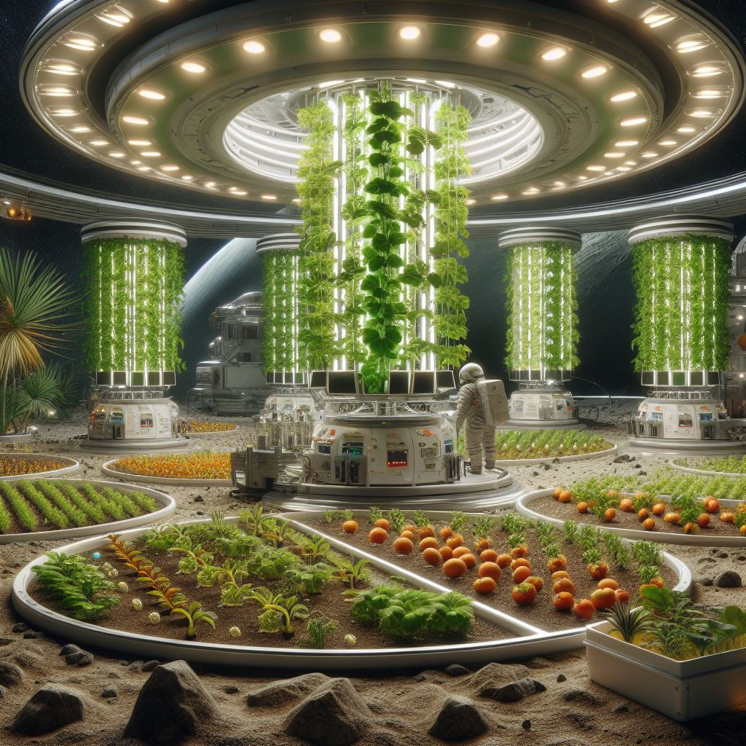
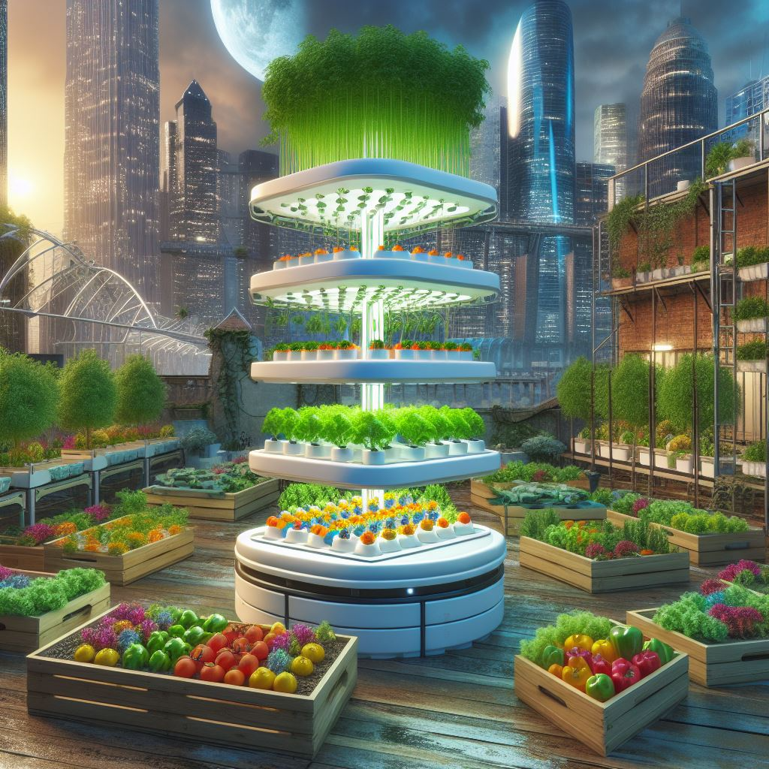
earth applications for Space biology research
MEDICAL INNOVATIONS
Therapies: Bone density, muscle, immune system, tissue engineering, regenerative medicine
Fundamental understanding: Cellular behavior, genetics, disease mechanisms
Applied: Biomedical devices, wearables, diagnostic tools, miniaturization, remote surgery
ENVIRONMENTAL MONITORING
Satellite-based Earth observation systems for monitoring natural disasters
AGRICULTURAL TECHNOLOGY
Hydroponics and aeroponics developed for space improve crop and water usage
Bioregenerative life support systems for sustainable farming and urban agriculture

Slide 19

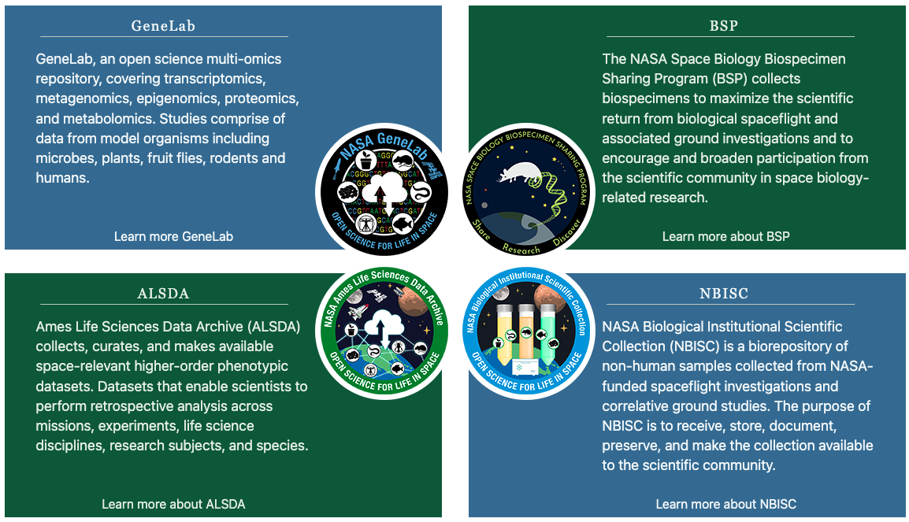

Open data for space biology
NASA Open Science Data Repository (OSDR)
osdr.nasa.gov/bio

Slide 20

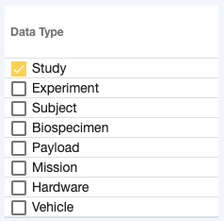
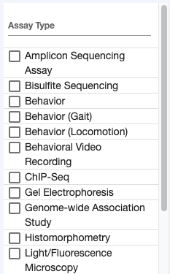
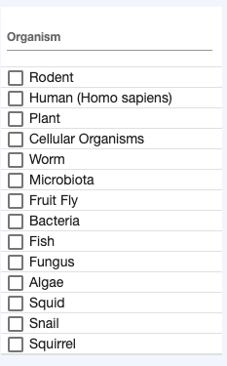
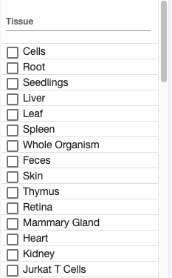
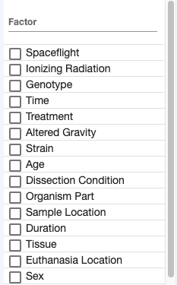
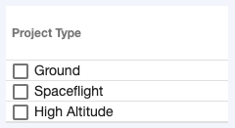
Open science data repository
SEARCH FILTERS

Slide 21
Live demo of study, payload, mission pages
https://osdr.nasa.gov/bio/repo/data/studies/OSD-48
https://osdr.nasa.gov/bio/repo/data/payloads/RR-1
https://osdr.nasa.gov/bio/repo/data/missions/SpaceX-4

Slide 22
Challenges for space biology research
Small “N” problem
Space biology experiments are expensive, making datasets small
Biological data is often high-dimensional (genomics, transcriptomics)
High-feature, low-sample count data makes it more difficult to model the complexity of biological systems and their interactions in space
Heterogeneous data types
Multi-modal data types can be generated from an experiment: e.g. transcriptomics, bioimaging, treatment variables, environmental telemetry data
Research findings using model organisms must translate and be relevant to human astronauts

Slide 23
Applications for machine learning in space biology
Biological analysis and research
Knowledge discovery
Hypothesis generation
Automated data management
Data structure, organization and transfer (Earth-Space)
Metadata organization and management
Automation of experimental payloads
In-situ analysis on board spacecraft or habitats

Slide 24
Future reading & references
Afshinnekoo, E. et al. Fundamental Biological Features of Spaceflight: Advancing the Field to Enable Deep-Space Exploration. Cell 183, 1162–1184 (2020)
Scott, R. T. et al. Biomonitoring and Precision Health in Deep Space supported by Artificial Intelligence. Nature Machine Intelligence (2023)
Sanders, L. M. et al. Biological Research and Self-Driving Labs in Deep Space supported by Artificial Intelligence. Nature Machine Intelligence (2023)
Berrios, D. C., Galazka, J., Grigorev, K., Gebre, S. & Costes, S. V. NASA GeneLab: interfaces for the exploration of space omics data. Nucleic Acids Res. 49, D1515–D1522 (2021)
Content assistance: GPT-3.5 and Copilot

